Slide 1

EXAM TIME TABLE SCHEDULER
Members:
Sonali Rasal - 02
Pranjal Singh - 24
Aroma Sinha - 30
GUIDE:
Ms. Nikki Modi

Slide 2
Abstract
Introduction
Literature Review
Problem Statement AND Proposed System
System Architecture
Software Used
Result and Discussion
Conclusion
Future Scope
Acknowledgement
References
AGENDA

Slide 3
ABSTRACT
In any educational institution, the two most common academic scheduling problems are course timetabling and exam timetabling. Graph coloring is one such heuristic algorithm that can deal timetable scheduling satisfying changing requirements, evolving subject demands and their combinations. This paper solely focuses on College Course Timetabling where both hard and soft constraints are considered. It aims at properly coloring the course conflict graph and transforming this coloring into conflict-free timeslots of courses. Course Conflict graph is constructed with courses as nodes and edges drawn between conflicting courses i.e. having common students. Exam scheduling is a challenging task for educational institutions. Our results show that the proposed algorithm is effective in generating conflict-free exam schedules in a reasonable amount of time.

Slide 4
INTRODUCTION
Exam time table is required in every educational institution.
In every semester or year, the universities and colleges are required to generate exam time table for conducting the internal and the final semester exams.
This problem consists of allocating a number of courses to a limited set of resources such as time slots, set of lecturers, lecture rooms, labs and group of students to satisfy predefined constraints.
A timetable has to satisfy all the constraints in order to be feasible.

Slide 5
LITERATURE REVIEW
In 2008, the Koala graph coloring library was developed which includes many practical applications of graph coloring, and is based on C++ [7]. In 2009, automata-based approximation algorithms were proposed for solving the minimum vertex coloring problem [8].
In 1986, Carter [19] in his examination timetabling survey refers to some of the above-mentioned graph coloring algorithms and heuristics and shows how graph theoretic approach to timetable scheduling is one of the most popular. It has been accepted and applied by many educational institutions to solve their examination timetabling problems. According to Carter in his survey, work of Mehta is significant as its objective of obtaining “conflict-free” schedules, given a fixed number of time periods turned out to be one of the most complex timetabling applications [15].

Slide 6
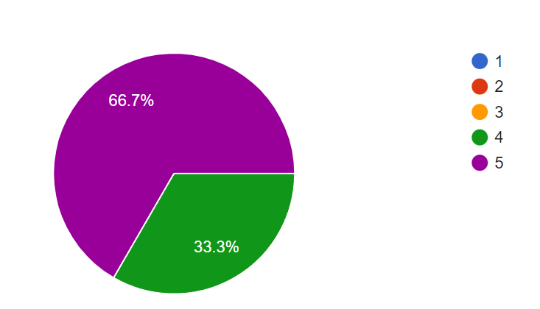
SURVEY
Q1
How many attempts were taken in preparing time table for exams?

Slide 7
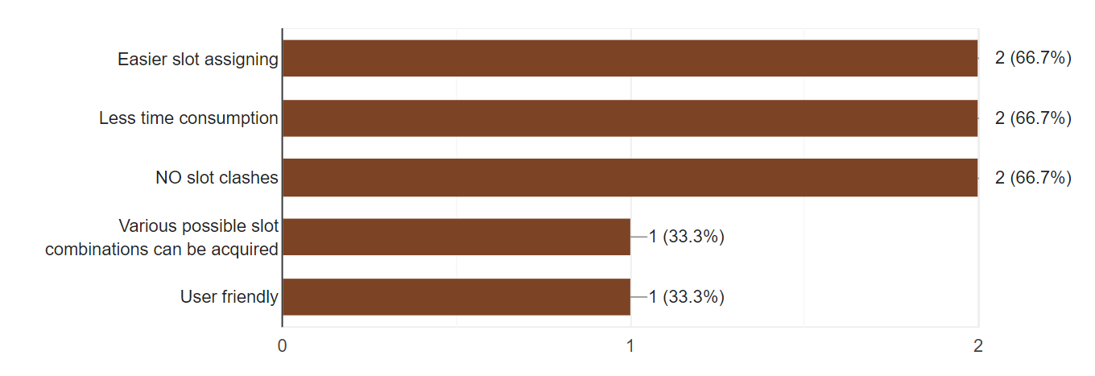
SURVEY
Q2
What all features do you keep in mind in order to create an exam time table?

Slide 8
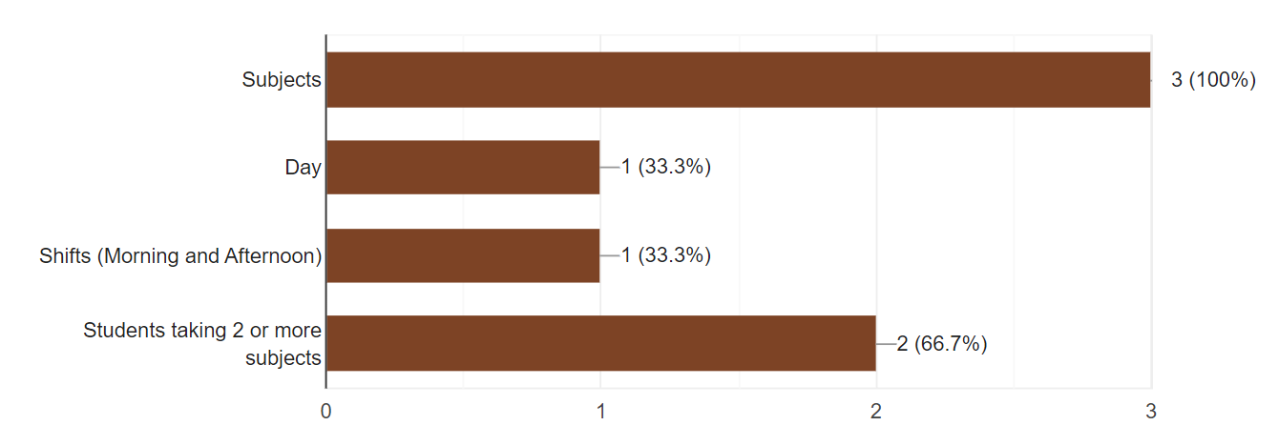
SURVEY
Q3
What do you expect from this automated system?

Slide 9
PROBLEM STATEMENT
Exam time table is required in every educational institution. In every semester or year, the universities and colleges are required to generate exam time table for conducting the internal and the final semester exams. The presence of vast numbers of offered courses makes it difficult to schedule exams in a limited epoch of time and often leads to clashing subjects of Subjects for similar semesters.

Slide 10



PROPOSED SYSTEM
Graph Coloring
Building an application
Preparation in seconds
Deal with timetable scheduling problem and can satisfy changing requirements.
Building an application to make it feasible to use.
Hassle – free preparation of time –tables.

Slide 11
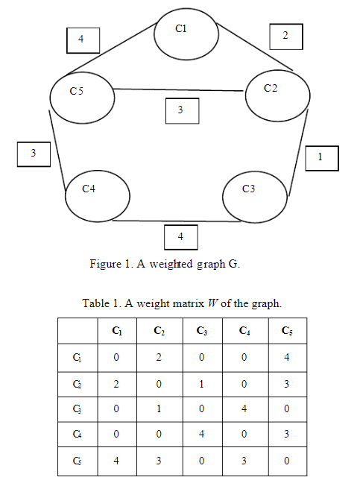
GRAPH REPRESENTATION
Graph coloring is one decent approach which can deal with timetable scheduling problem and can satisfy changing requirements.
In this work, we have framed a systemic model by applying graph vertex coloring approach for generating exam timetabling with the help of a course matrix generated from given data of an educational institute.
For Every Adjacent Vertex we gave it different color so that it doesn't clashes in same slot.
Time Complexity of Algorithm: O(n2)
Space Complexity of Algorithm: O(n2) , where, n is number of Subjects

Slide 12
SYSTEM ARCHITECTURE
Add slots
Add sem number
Exam Time Table Generator
Add clg name
Add subjects
Exam Time-Table Generator is simple and easy to use application which takes Semester Subjects and Maximum number of slots as input from the user and displays the Schedule for examination with no subjects of same semester clashing in slot.
Add kt subjects

Slide 13
SOFTWARE USED
Software: Visual Studio Code
Language :C++

Slide 14
RESULT AND DISCUSSION
Our backtracking algorithm works by assigning exams to time slots one by one, starting from the first day and proceeding to the last day. The algorithm uses a recursive approach, which explores all possible solutions and backtracks when a conflict arises.
The algorithm maintains a list of unassigned exams and a list of available time slots for each exam. It then selects an unassigned exam and iterates through all available time slots.
If a time slot is found that does not conflict with any other assigned exams, the exam is assigned to that time slot, and the algorithm moves on to the next unassigned exam.
If no feasible time slot is found, the algorithm backtracks to the previous exam and tries a different time slot.
https://github.com/AromaSinha/Exam-time-table-scheduler

Slide 15
CONCLUSION
Exam time table is required in every educational institution.
In every semester or year, the universities and colleges are required to generate exam time table for conducting the internal and the final semester exams.
Hence, this approach can solve a big time taking problem and prepare hassle- free time-tables . Graph Coloring indeed helps in solving this issue.

Slide 16
FUTURE SCOPE
Hybrid Approaches: Hybrid approaches that combine multiple algorithms such as Genetic Algorithm and Tabu Search can potentially lead to better solutions. For example, a hybrid algorithm can use Genetic Algorithm to generate initial solutions and then use Tabu Search to refine them further.
Constraint Programming: Constraint Programming is a technique that has shown promising results in solving scheduling problems. It can be used to model the constraints and requirements of the problem and solve it efficiently. Constraint Programming can be used in conjunction with Backtracking Algorithm to improve the efficiency of the algorithm.
Machine Learning: Machine Learning techniques such as Reinforcement Learning can be used to learn from past solutions and improve the efficiency of the algorithm. For example, a Reinforcement Learning-based algorithm can learn from past solutions and adapt to new problem instances.

Slide 17
ACKNOWLEDGEMENT
We gratefully acknowledge the support, guidance, and encouragement of my Dissertation Guide Assistant Professor Ms. Nikki Modi ma’am for this novel work.

Slide 18
REFERENCES
[1] Kenneth, A., and Wolfgang, H., 1977, “Every Planar Map is Four Colorable. I. Discharging,” Illinois Journal of Mathematics, 21(3), pp. 429–490.
[2] Heawood, P. J., 1980, “Map-Colour Theorems, 1980,” Quarterly Journal of Mathematics, Oxford, 24, pp. 332–338.
[3] Birkhoff, G.D., 1912, “A determinant formula for the number of ways of coloring a map,” Annals of Mathematics, 14, pp. 42-46. 484 Runa Ganguli and Siddhartha Roy
[4] Deo, N., 1990, “Graph theory with applications to engineering and computer science,” Prentice Hall of India.
[5] Bondy, J. A., 1969, “Bounds for the chromatic number of a graph,” Journal of Combinatorial Theory, 7, pp. 96-98.

Slide 19

THANK YOU

